Slide 1
Opening an international location for Lune et Jardin
Archie Bye

Slide 2
Introduction
Who are Lune et Jardin?
An established French restaurants with two locations in Paris.
What problem do they have?
They want to open a restaurant in London but don’t know the area.
Can we solve it for them?
Yes! With data!

Slide 3
Data
Foursquare
To give us information about commercial establishments around a given set of coordinates. We will use the data to characterise the locations of the restaurants in Paris.
Neighbourhoods
Data about the names and locations of neighbourhoods in London and Paris has been scraped from Wikipedia.

Slide 4
Methodology
Scraping and cleaning the data
Visualise the neighbourhood data on a map using Folium
Iterate through the neighbourhoods for both Paris and London and get the data about commercial establishments in each of the neighbourhoods.
We can now cluster the neighbourhoods of Paris to see if the current locations of the Lune et Jardin restaurants fall into the same cluster.

Slide 5
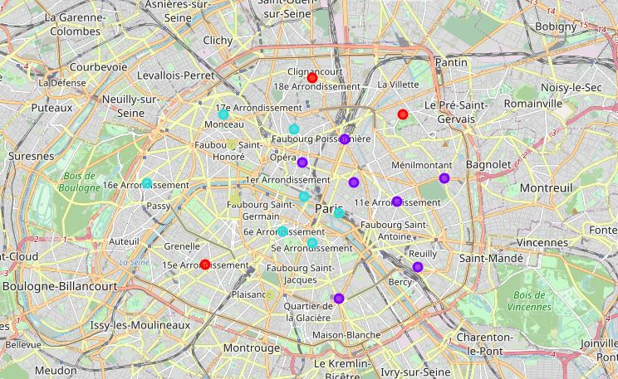
Paris Clustering
Current Lune et Jardin locations are in the same cluster.

Slide 6
Methodology cont.
We get the average feature values for the cluster that the Paris locations fall in.
We use this average value to find a suitable London location.
We use Cosine Similarity to find this new location.

Slide 7
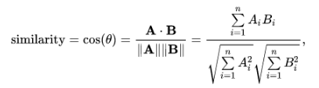
Cosine Similarity

Slide 8
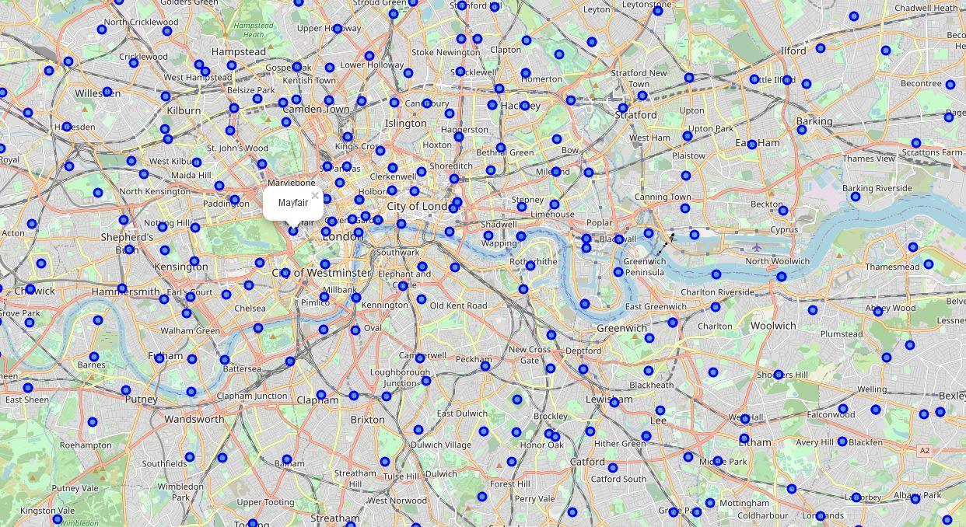
Results

Slide 9
Conclusion
How did it go?
Lune et Jardin should be happy with the results of this analysis and could easily use these results to move forward with their international expansion.
How can we improve?
More data!

